Slide 1
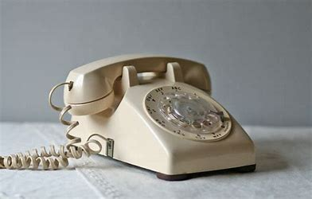
The Evolution of Smartphones
From the humble rotary phone to powerful handheld computers, explore the fascinating history and transformation of smartphones.

Slide 2
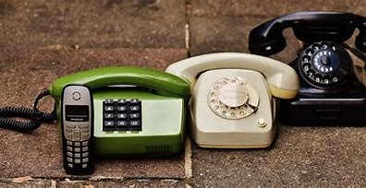




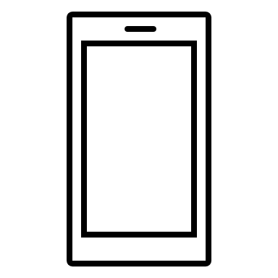
The First Mobile Phone Call

Slide 3
The First Mobile Phone Call
The Brick Phone 📱
In 1973, the Motorola DynaTAC "brick" phone made its historic debut as the world's first handheld cellular phone.

Slide 4
The First Mobile Phone Call
The Iconic DynaTAC
With a price tag of $3,995, the DynaTAC boasted an impressive 30 minutes of talk time and set the standard for future mobile phones.

Slide 5
The First Mobile Phone Call
The First Call 📞
In 1983, on the streets of New York City, Motorola engineer Martin Cooper placed the world's first mobile phone call to his rival at Bell Labs to declare victory in the race to create the first handheld mobile phone.

Slide 6
The First Mobile Phone Call
The First Smartphone
In 1992, IBM unveiled the Simon Personal Communicator, the first device to combine a mobile phone, a pager, a fax machine, and a personal digital assistant (PDA).

